Slide 1
Capacitors and
Alternating Current (AC)
II. Simulation
Week 9a

Slide 2
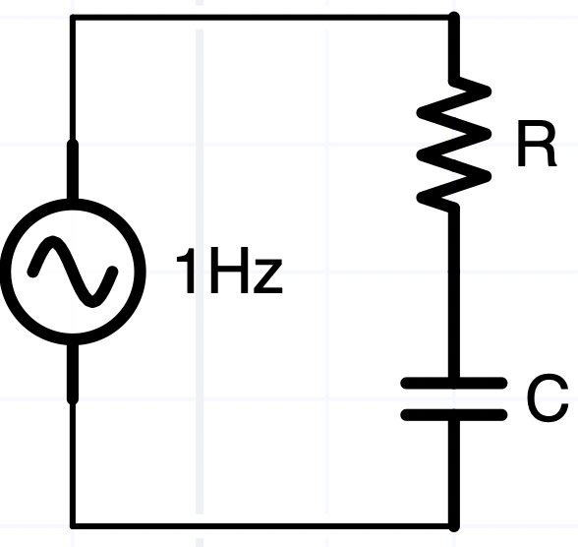
Sinusoidal RC circuit
Find the voltage, current, and power of a 10kΩ +.1μf capacitor connected to 120V 60 Hz (Note: don’t try this with a wall outlet – its too dangerous!)
  What’s the first step?
    draw a schematic (think visually)
  What’s the input voltage, Vo?
    V(t) = 120*sqrt(2)* cos(2π60t) = Re(170*exp(j2π60t))
  What’s the impedance?
    Z_{c} = 1 / (jωC) = 1/(j2π (60/s)(.1 e-6F)) Ω = −j26KΩ
    Z_{R} = R = 10KΩ
  What’s the current?
    i = V/Z_{series} = V/(Z_{R}+Z_{c}) = 170V/(10-j26)K = (2.2+j5.7) mA
  I got the last result using Matlab’s inherent knowledge of complex number rules
  What’s the phase between V and I?
V₀e^{jωt}

Slide 3
Matlab Simulation
%% simulation of RC series circuit
% Emec/Phys 310 29sept20 BR
j = sqrt(-1); % matlab knows this by default
R = 10e3;% ohms
C = .1e-6;% farads
freq = 60;% hz
Vo = 120;% volts rms
Zc = 1 / (j*2*pi*freq*C);
Vr = Vo * R / (R+Zc); % voltage divider equation
Vc = Vo * Zc / (R+Zc);
%
fprintf('rms(Vr) = %.1fV at %.1fdegrees\n',abs(Vr), angle(Vr)*180/pi);
fprintf('rms(Vc) = %.1fV at %.1fdegrees\n',abs(Vc), angle(Vc)*180/pi);
i = Vo/(R+Zc);
fprintf('i = %.1fmA at %.1fdegrees\n', abs(i)*1e3 ,angle(i)*180/pi);
fprintf('power = %.1fmW\n',Vr * i' * 1e3); % note ' takes conjugate
Produces:
|Vr| = 42.3V at 69.3degrees
|Vc| = 112.3V at -20.7degrees
i = 4.2mA at 69.3degrees
power = 179.2mW
→ The current is in phase with Vr (always). Vc is 90 degrees behind Vr. Neither are in phase with the source, Vo.

Slide 4
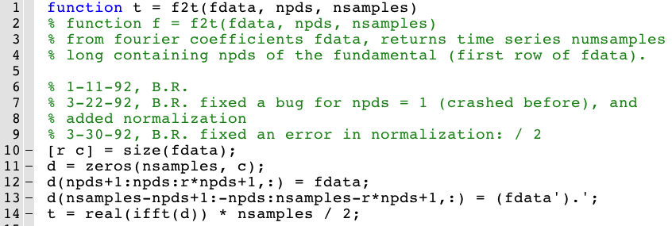
Time domain
This function f2t() converts complex amplitudes (“frequency domain”) to “time domain” waveforms, using the inverse Fourier transform (ifft)
  Understanding the “index gymnastics” below takes some experience … don’t worry about treating this function as a “black box”

Slide 5
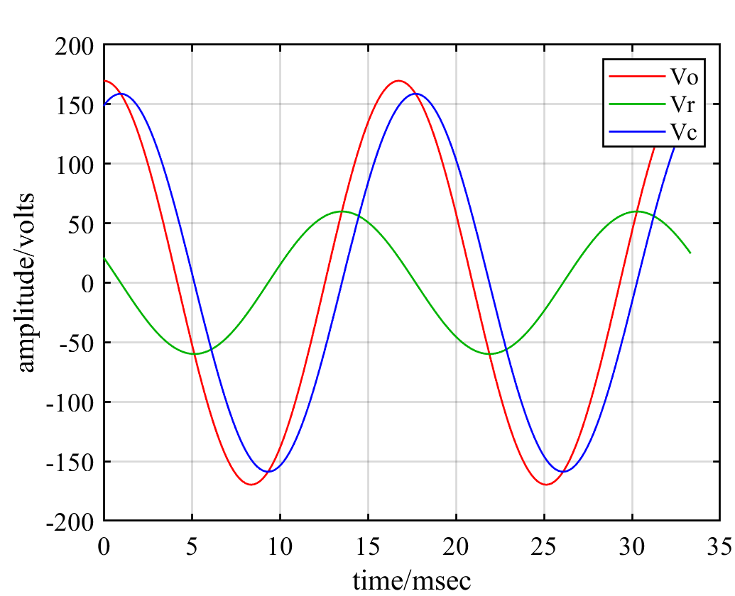
Simulated waveforms
waveforms = f2t([Vo Vr Vc] ...
* sqrt(2),2,200);
% sqrt(2)* Vrms = amplitude
% 2 periods, 200 time points
clf
t = linspace(0,2/60,200)' *1e3;
% msec
plot(t,waveforms)
grid; legend('Vo','Vr','Vc')
xlabel('time/msec');
ylabel('amplitude/volts')
print -djpeg wfs.jpg
Can you visualize KVL:
Vo = Vr+Vc at all times
Prove it with Matlab

Slide 6
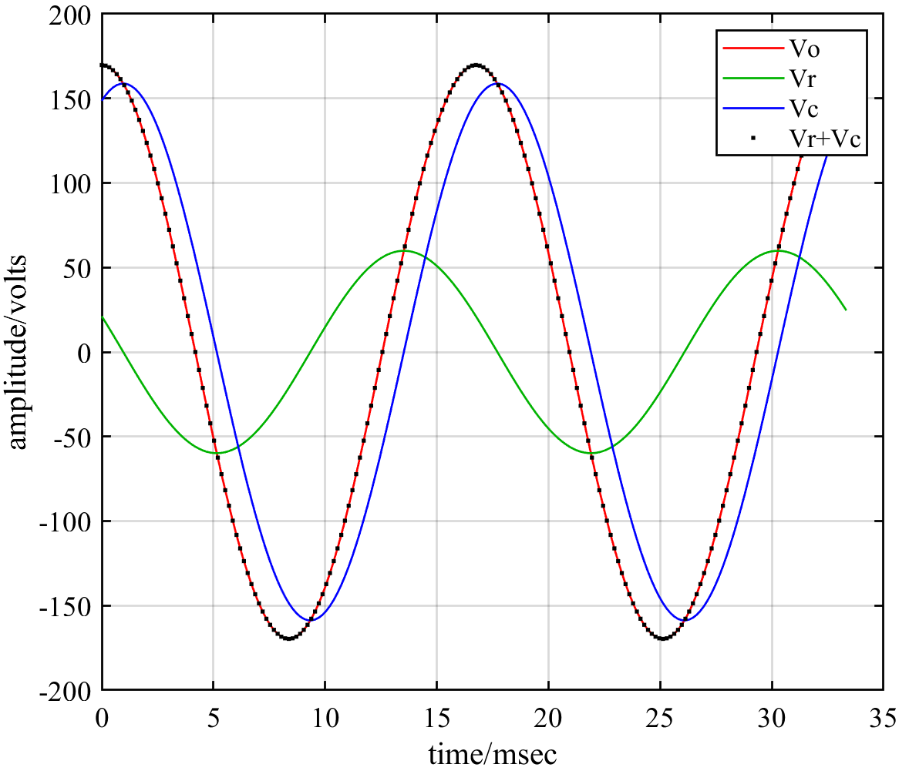
Kirchhoff’s Law
hold on;
plot(t, waveforms(:,2)+...
waveforms(:,3),'.k')
➔KVL applies at every
instant in time
But RMS voltages (as
displayed on multi-
meters) and amplitudes
do not generally add
  is true at all times.
But
BTW, this demonstrates a remarkable feature of sinuosoids: the sum of 2 sine waves with the same frequency (blue+green) is another sine wave of the same frequency (red). The sum of e.g., 2 square waves is (generally) not another square wave!

Slide 7
Bode Plot
How does amplitude and phase behave in this R-C series circuit if we vary the frequency?
R = 10e3; C = .1e-6;
freq = logspace(0,4)'; % vary f over 4 logs
w = 2 * pi * freq; % w is a vector with 50 elements
Zc = 1 ./ (j*w*C); % pointwise division
Vr = Vo * R ./ (R+Zc);
Vc = Vo * Zc ./ (R+Zc);
clf; subplot(2,1,1);
loglog(freq,abs([Vr Vc])/Vo); axis tight; grid
ylabel('gain');
subplot(2,1,2);
semilogx(freq, rad2deg(angle([Vr Vc]))); grid;
ylabel('phase/degrees'); xlabel('frequency/Hz');
fc = 1/(2*pi*R*C); % corner frequency
hold on; a = axis; plot([fc fc],[a(3) a(4)], ':b'); hold off;
legend('Vr','Vc','fc');
subplot(2,1,1); hold on; a = axis; plot([fc fc],[a(3) a(4)], ':b');
title('Bode plot of RC series circuit')
V₀e^{jωt}
Wikipedia Bode_Plot for more detail

Slide 8
bodePlot.m
function bodePlot(f,a)
% function bodePlot(frequency,amplitude)
% generate a bode plot in the current figure window
% amplitude is assumed complex and normalized
% 27oct20 BR
% 5apr21 BR added unwrap
clf;
subplot(2,1,1)
loglog(f,abs(a),'.-')
ylabel('amplitude');
grid; axis tight;
subplot(2,1,2)
semilogx(f, unwrap(angle(a))*180/pi,'.-')
xlabel('frequency'); ylabel('degrees');
grid; axis tight
end
(Homework: add an optional 3rd argument fc to indicate the corner frequency)

Slide 9
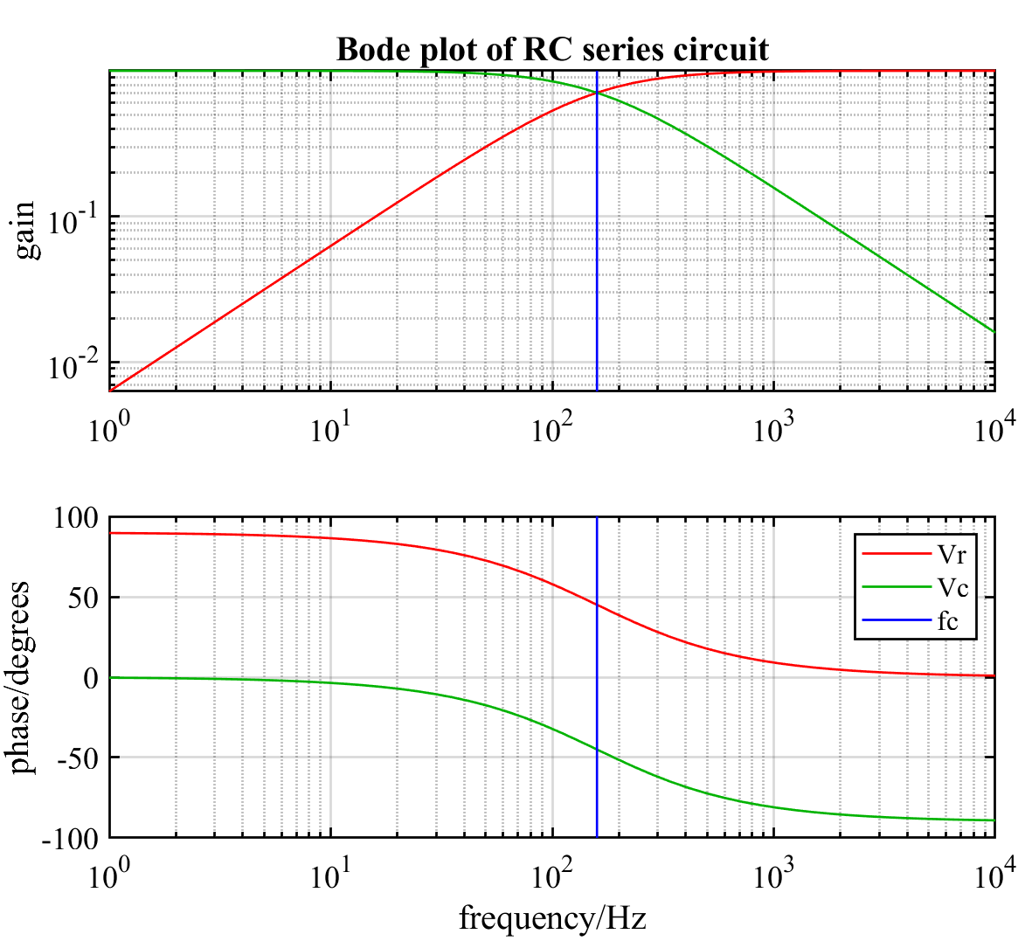
Bode Plot
At low frequencies (left), the capacitor dominates, |Zc| >> R, Vc ~ V_{in}, and current is 90°phase shifted
At high frequencies, the resistor dominates, R >> |Zc|, V_{R}~V_{in}, and current and voltage are in phase
The “corner frequen-cy”, fc = 1/(2*pi*R*C) is the transition, where |Zc| = R, |V_{R}| = |Vc| at phases ±45°relative to V_{in}

Slide 10
Decibels
Plotting the frequency response on a loglog plot, the two regimes of R-dominance and C-dominance are piecewise linear, the asymptotes crossing at the “corner frequency”
The y-axis is typically specified in decibels:
db_{amplitude} =10 * log₁₀(Vout/Vin)
Often power ratios are plotted, and since power ~ V²/R,
db_{pwr} = 10 log₁₀(Vout/Vin)² = 20 log₁₀(Vout/Vin)
A difference of 3dB means 3 = 10log10(Vout/Vin) → Vout/Vin=10^.3 = 2. So if one voltage is 3db more than another, that means its twice as big, -3dB means ½ as much, …
If a signal goes through 2 amplifiers in series, the first has a gain of 3dB and the second 5dB, then how much bigger is the signal coming out?
3dB + 5dB = 8dB (since log(A*B) = log(A) + log(B)
→ When measuring gain in dBs, add instead of multiplying … easier

Slide 11
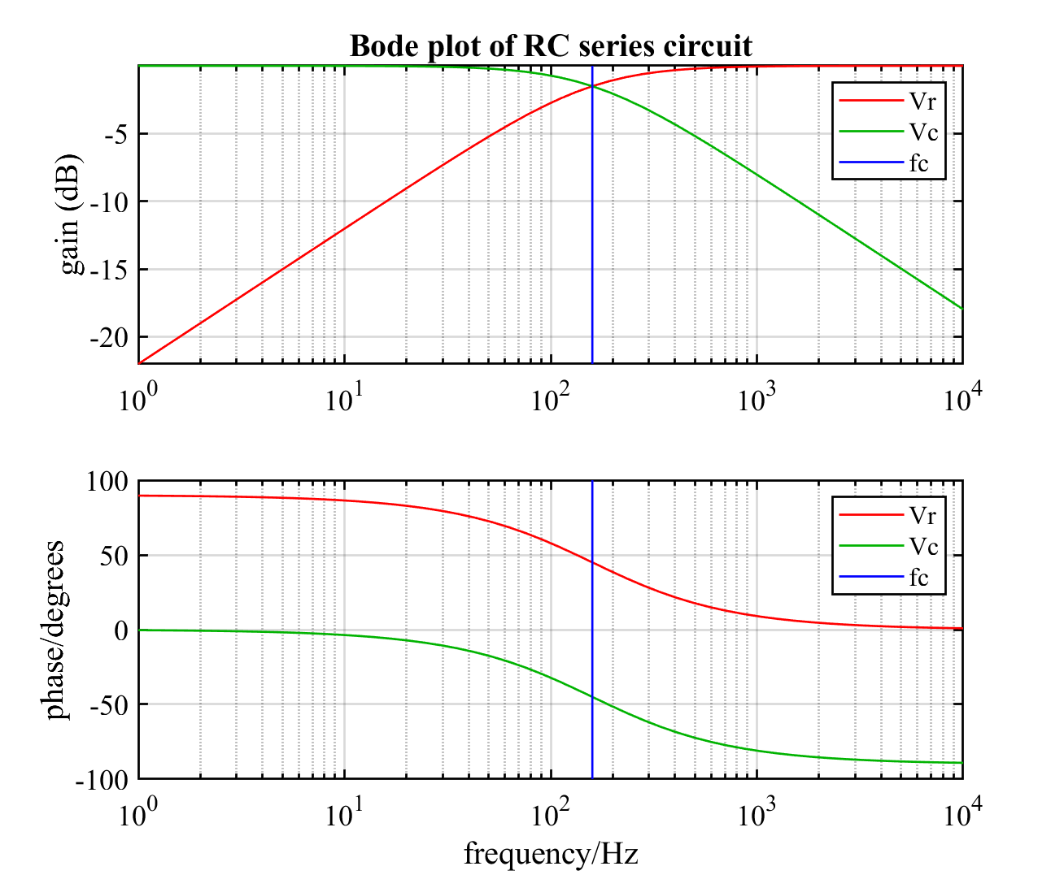

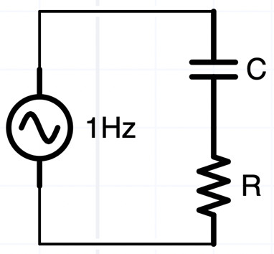
R-C circuits are frequency “filters”
“Low pass filter”
“High pass filter”
Vout/Vin
Vout/Vin
Note: Just changed the top plot to:
semilogx(f,10*log10(abs([Vr Vc])/Vo)); ylabel('gain (dB)')

Slide 12
Time vs. Frequency domains
It’s often easier for us to think in the time domain, i.e., V(t), voltage plotted vs. time
  Oscilloscopes usually operate in the time domain
Most AC circuit analysis is done in the frequency domain!
  V(f) or V(ω), voltage plotted vs. frequency
  Spectrum analyzers, and other instruments: network analyzers, impedance analyzers, display the frequency domain continuously in “real time”
  Time domain behavior can be easy to predict from frequency domain analysis
Some modern digital oscilloscopes and analyzers can display both at the same time … (fun toys!!)

Slide 13
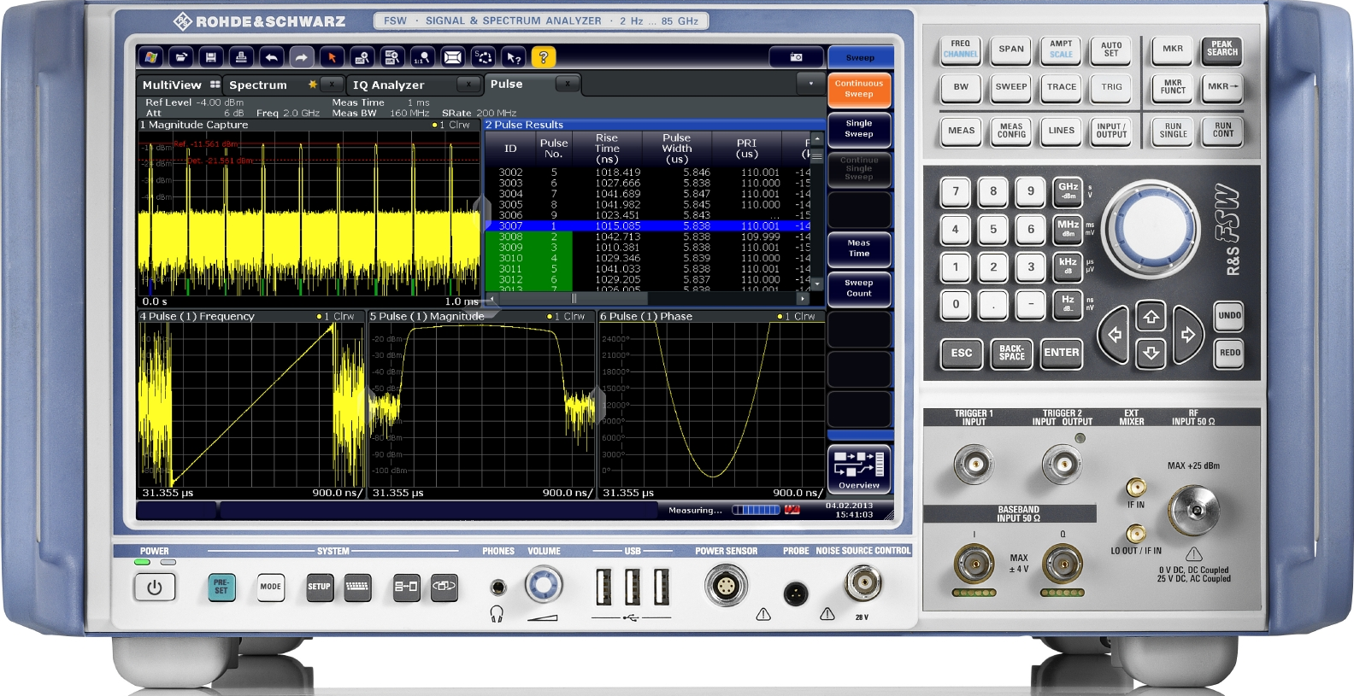
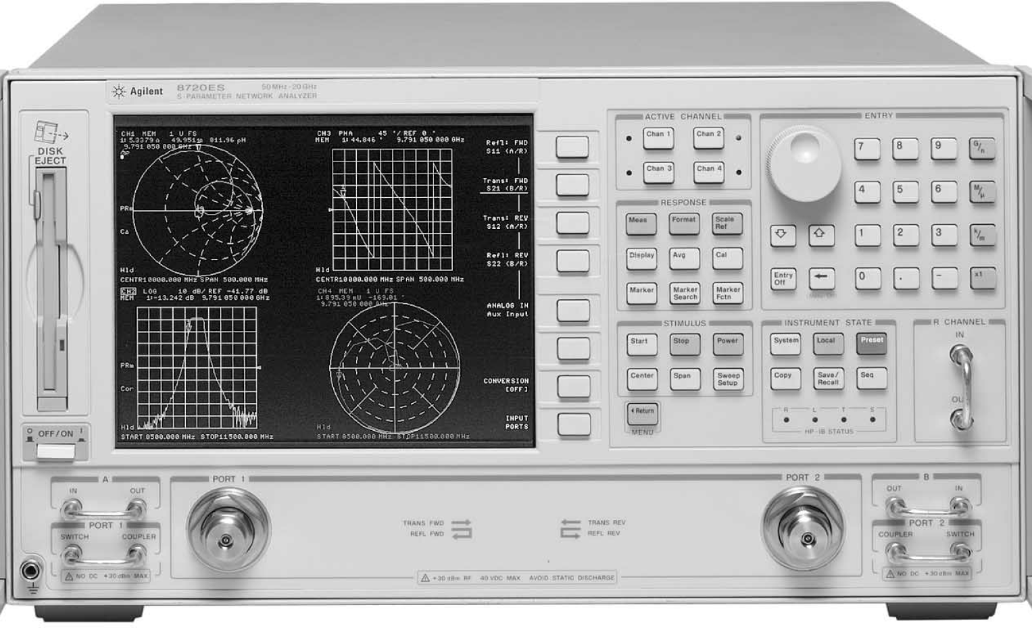
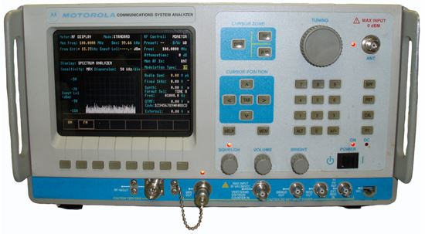
Frequency domain analyzers
Spectrum analyzers, network analyzers, and service monitors (for radios) facilitate debugging in the frequency domain
They are $$$$

